Slide 1
GE MRI SYSTEM NAMES AND HISTORY
2014 Leadership Meeting

Slide 2
Objectives:
To understand the system names and be able to locate them in time
Understand the differences between family names, software platform, magnet types
Be able to identify and narrow down the system we are working on

Slide 3
GE MRI Families
SIGNA
SIGNA HORIZON
SIGNA EXCITE
DVMR/DISCOVERY
OPEN SYSTEMS
JAPANESE/CHINESE SYSTEMS

Slide 4
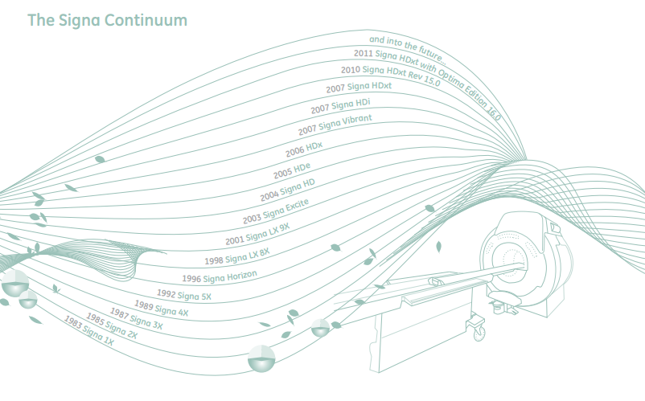
Signa 1983 - 2017
1X,2X,3X,4X, 5X, 8X, 9X… you get the idea…

Slide 5
LX-9x
LCC Magnet with no He consumption is introduced
Unix systems with Octane computer. It also has a separate windows PC and monitor for scan time and patient vital signs only
Big reduction in equipment room
Gradients start getting powerful

Slide 6
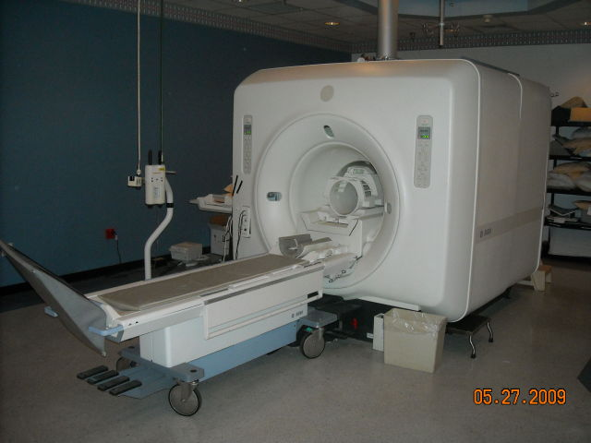
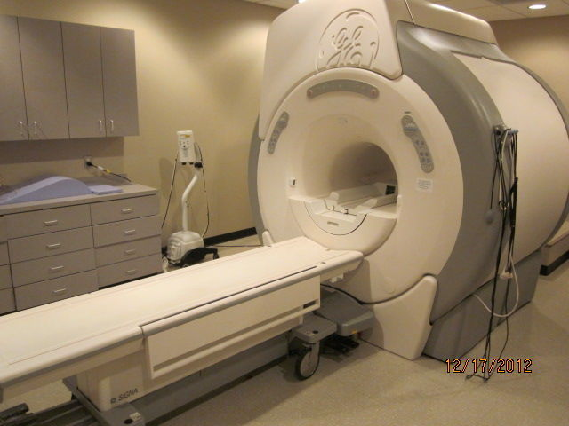
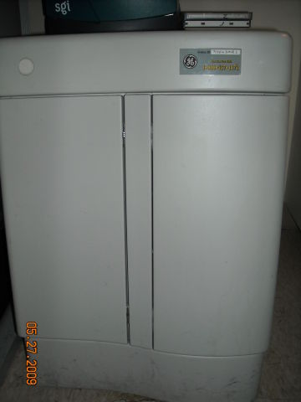
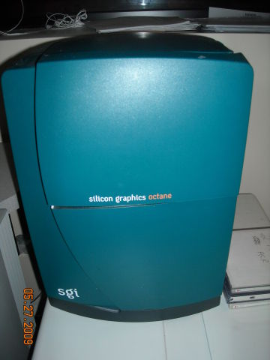
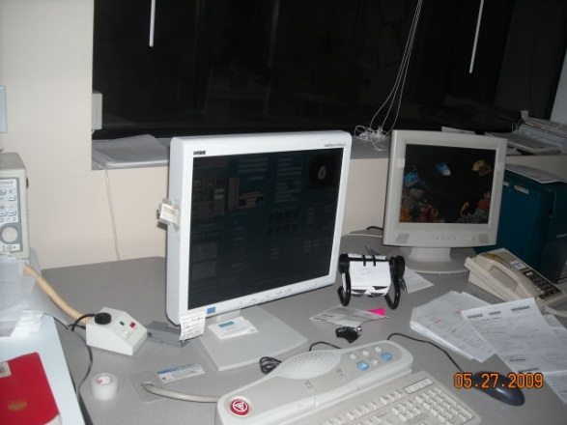
LX-9x

Slide 7
Excite: 10x, 11x,12x,14x,15x,16x,23x
Linux computers are introduced
Two monitors and one HP computer
MGD chassis
Advance signal and image processing using new processors
New plastic covers
Introduces ICN engines for image reconstruction

Slide 8
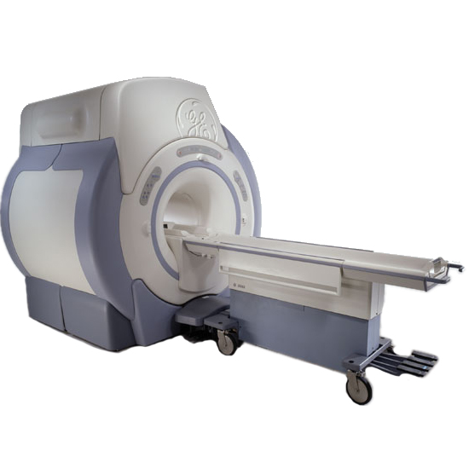
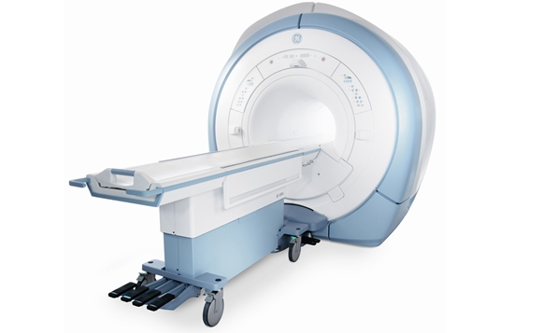
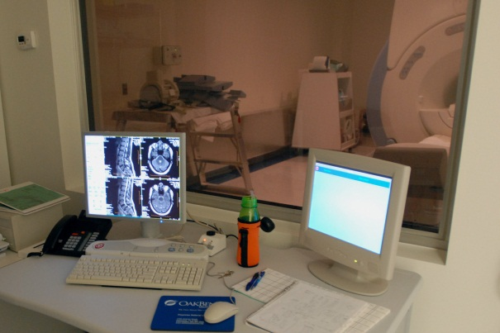
Excite: 10x, 11x,12x,14x,15x,16x,23x

Slide 9
HDxt: 15x,16x,23x
Reduction of cabinets
Gradients get extremely powerful
Big development of options and applications
16x it’s a purchasable option that introduces many cardiac options
16x had many software issues

Slide 10
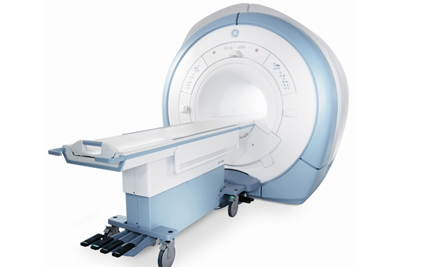
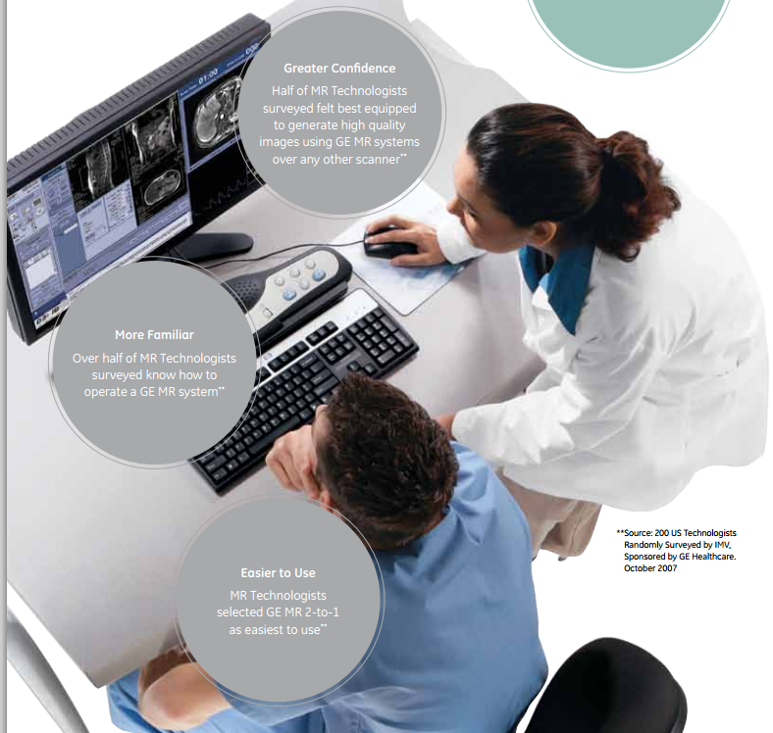
HDxt: 15x,16x,23x
23x it’s introduced
Mostly software changes
Brings the Discovery software to the HDXt platform and fixes many of the problems that 16 and 16V2 had introduced

Slide 11
2009 THE DVMR ERA STARTS
The upgrade path is no longer possible
Introduces around 3000 new parts
All new documentation
Change in many calibration procedures
New software look with openSUSE as OS
20x,21x,22x,24x,25x
New table, coils, coil connectors, magnets, gradient coils. Everything is pretty much redesign
Fiber optic image transfer and reconstruction gets done in the magnet room.
Higher water and room requirements
Cabling is routed through the ceiling
Water cooled gradients
16 or 32 Channels architecture but can support up to 128 channels.

Slide 12
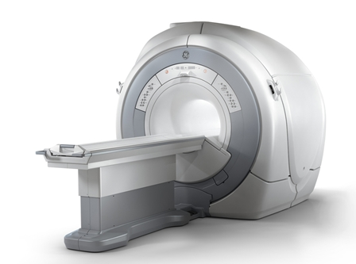
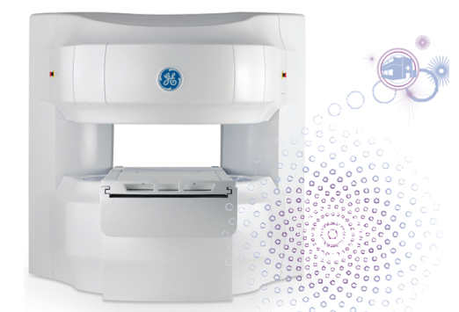
DISCOVERY
OPTIMA
PERFORMANCE
Price
BRIVO

Slide 13
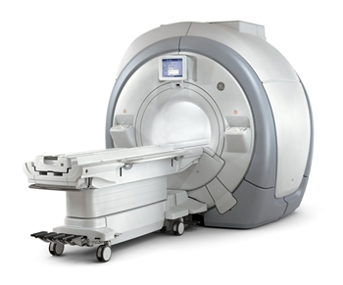
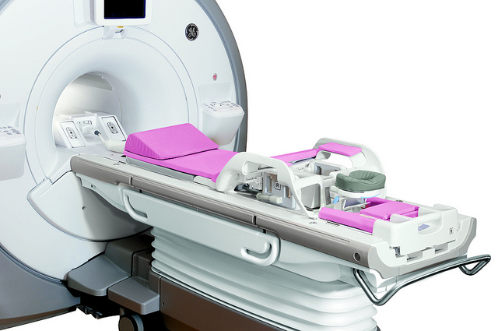
Discovery 450
Uses the 1.5T LCC magnet
New XRMB gradient coil
16 or 32 channels
New In room display
Patient information can be entered at the magnet
Optional touch-and-go landmark

Slide 14
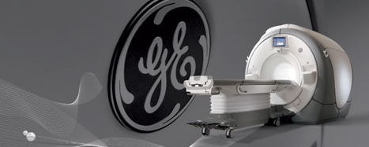
Discovery 750
Uses the 3T LCC300 magnet
Combines passive and active shimming
New XRMB gradient coil
16 or 32 channels

Slide 15
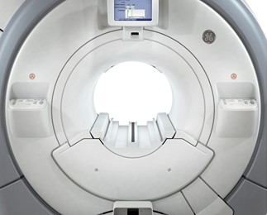
Optima 450W
70cm bore
16 or 32 Channels
RF body coil needs adjustment by soldering dielectric material if out of spec or coil replacement
New 1.5T magnet
New XRMw gradient coil
Only passive shimming
GE recommend reshimming every 12-18 months

Slide 16
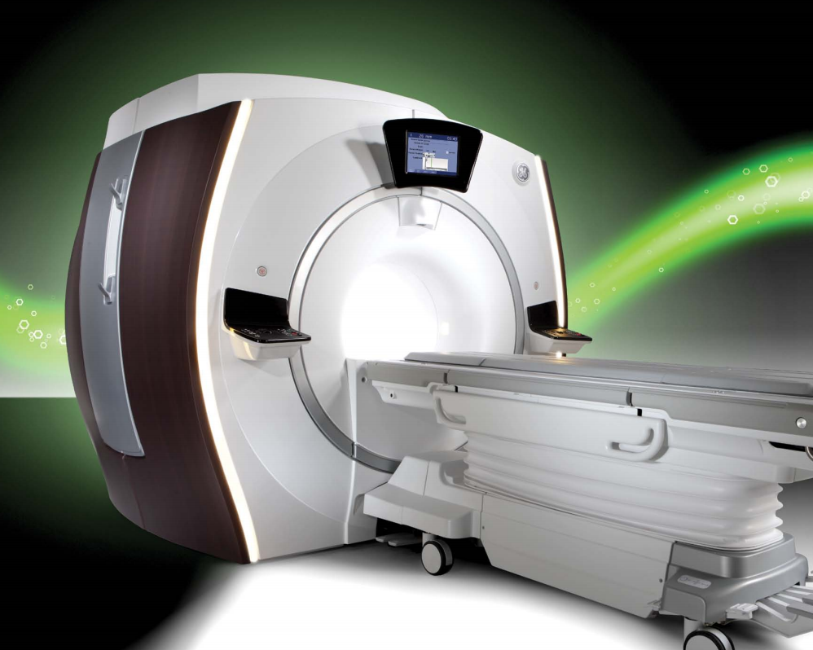
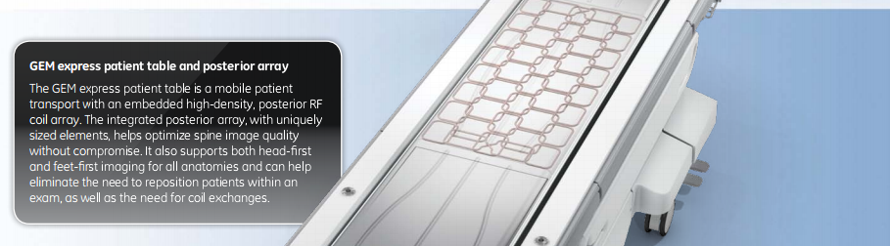
GEM (Geometry Embracing Method)
Introduces new covers
GEM Express coil – embedded coil in the table
New coils
IPAD capabilities

Slide 17
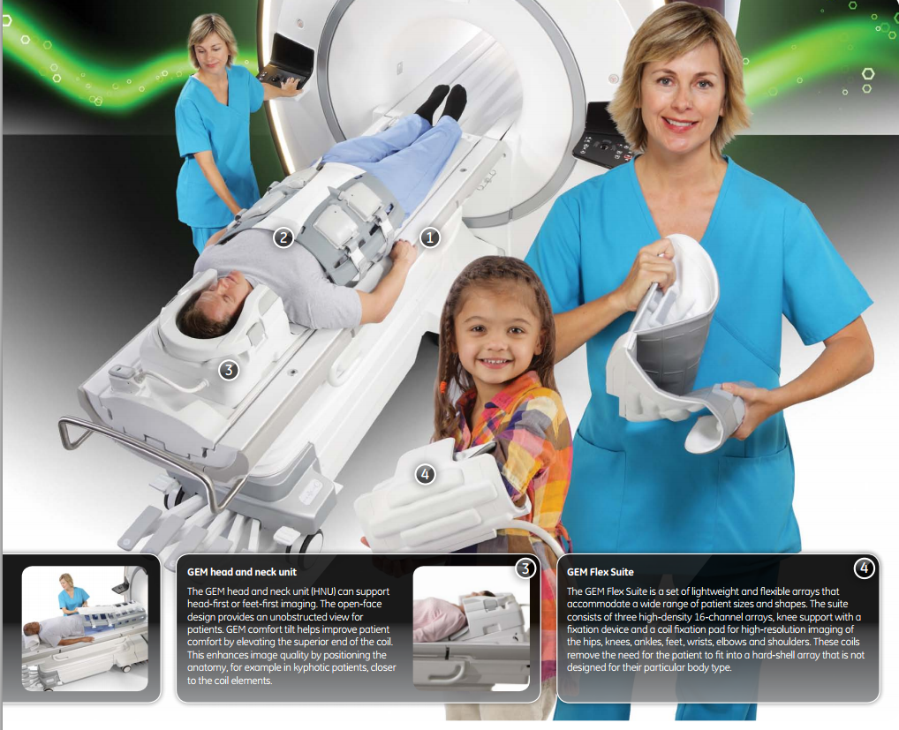

Slide 18
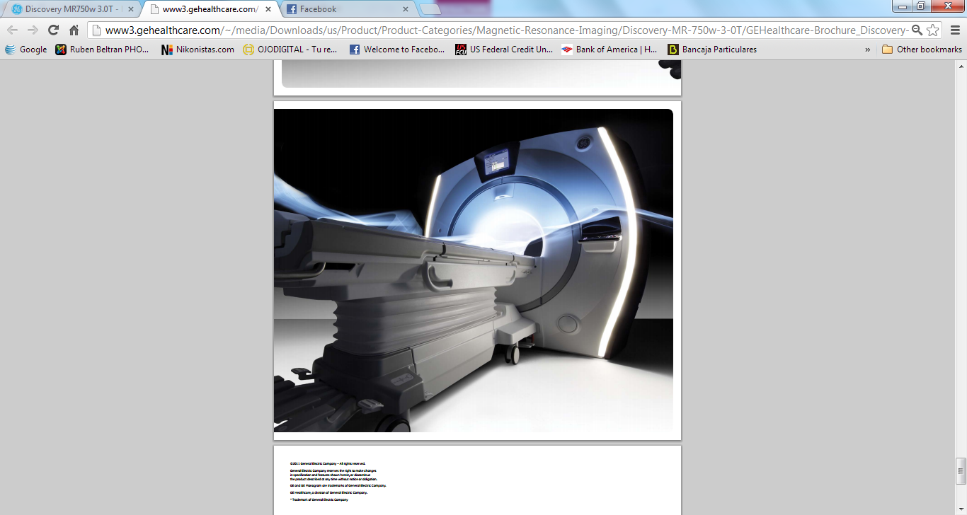
Discovery 750W
750w is only sold as GEM and 32 channels
New 3TLC magnet
Only passive shimming
New STET tool to drive in and out shim trays
New dual drive RF amplifier for better homogeneity and to reduce shading
RF Body coil needs calibration in the field when replaced
Adjustable capacitors for fine tuning
Rough tuning dielectric material does not need soldering

Slide 19
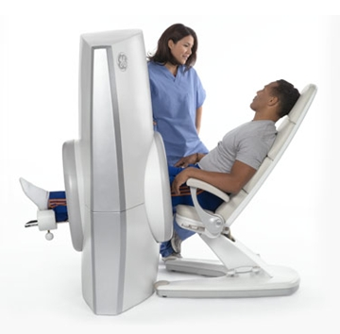
Optima 430S
Specialty MR – extremities only
Company called ONI bought out by GE in 2009
Superconducting magnet with 50l of liquid He
Passive shimming only
High field 1.5T (some old ONI 1T still out there)
Small foot print between 222 and 250 sqft typically
High power with 70 mT/m and a 300 T/m/s of slew rate
6 different coils
Comparable or in some cases better image quality than whole body systems
About 30% of exams done in a whole body system are extremities

Slide 20
CHINA BASED SYSTEMS

Slide 21
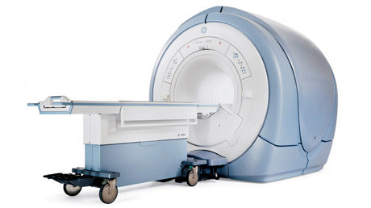
HDe
Uses the same technology as the Excite technology
Develop by the Chinese/Japanese to reduce space and cost
Combines all the electronics and penetration panel into one cabinet

Slide 22
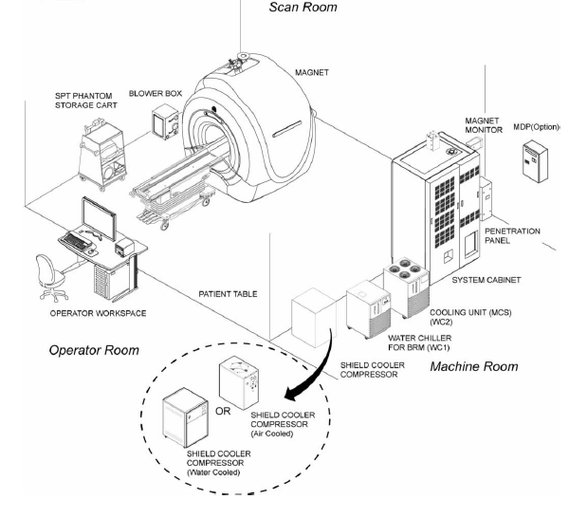
HDe
Only 4 channel capability
Small gradients with only 23 mT/m and 50T/m/s of slew rate

Slide 23
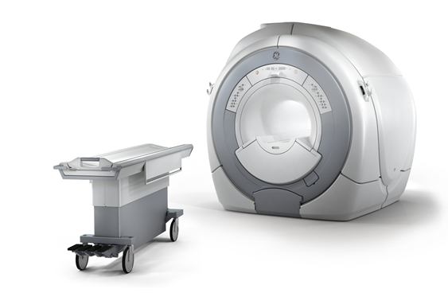
Optima 360 & Brivo 355
Replaces the HDe
Follows the same installation layout as HDe
Based on the DVMR technology
Uses FO and reconstruction engine inside the magnet room.
Up to 8 channels
Improved gradients 50mT/m and 150T/m/s of slew rate

Slide 24

Optima 360 & Brivo 355
Optional embedded coil in the table if fix table option is purchased (most systems sold with this configuration)
Optima 360 can have fixed or detachable table, but Brivo 355 can only have fixed table
The difference between the Brivo and the Optima is only options and customer can buy the upgrade which consist of only option installation and does not require any hardware changes
It is also possible to upgrade from HDe to Optima 360
Uses 20x software with same user interface as the DVMR platform

Slide 25
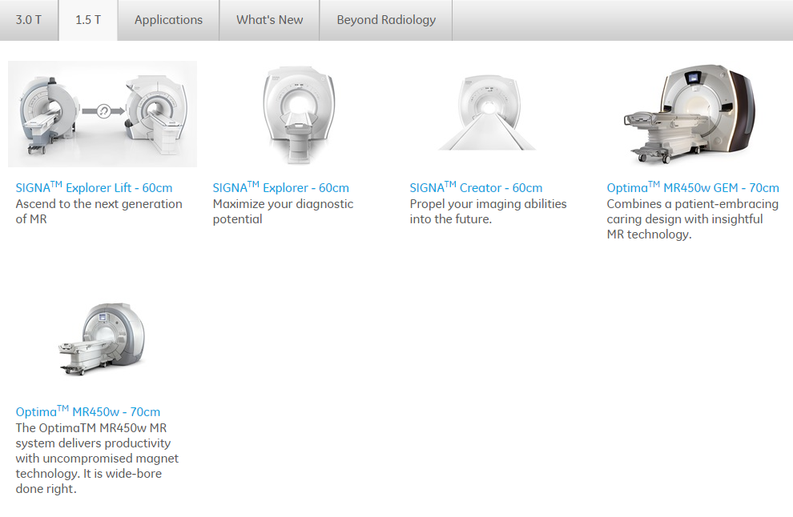
Present -1.5T
http://www3.gehealthcare.com/en/products/categories/magnetic_resonance_imaging#tabs/tabC05A5EC71691403AB6E068118D80BDEB

Slide 26
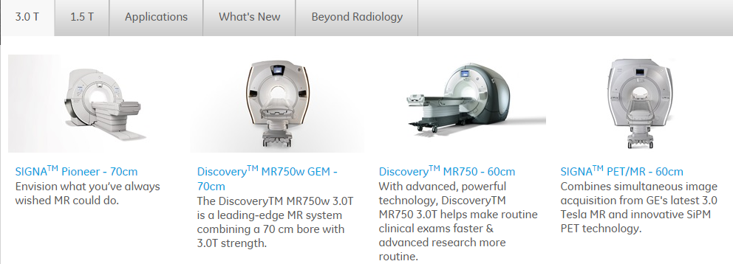
Present -3T
http://www3.gehealthcare.com/en/products/categories/magnetic_resonance_imaging#tabs/tabBB20FB1CC2684944AF3AC59867514D34

Slide 27
Possible combinations
 |  | SYSTEMS | SIGNA |  |  |  |  |  |  |  | DV/DVApps/DVMR/TNT |  |  |  |  |  | China Systems
 |  |  | Signa |  |  |  |  |  |  |  | Optima | Discovery |  |  | GEM |  | HDE | Brivo |  | Optima
 |  |  | Horizon LX |  | Excite | HD | HDx | HDxt |  |  | 450W | 450 | 750 | 750W | 450W | 750W |  | 355 | 355 Inspire | 360 | 360 Advance
 |  |  | SOFTWARE
MAGNETS |  |  | 8x | 9x | 11x | 12x | 14x | 15x | 16x | 23x | 22x/24X/25X | 22x/24X/25X | 22x/24x/25X | 22x/24x/25X | 24X/25X | 24X/25X | 11x-15x | 22x |  | 22x
1.5T | Cx |  | X | X
 | SII |  | X | X | X | X
 | SIII |  | X | X | X | X
 | SIV |  | X | X | X | X | X | X | X | X
 | SV |  | X | X | X | X | X | X | X | X
 | LCC |  | X | X | X | X | X | X | X | X |  | X |  |  |  |  | X | X | X | X | X
 | 450W |  |  |  |  |  |  |  |  |  | X |  |  |  | X
3T | 3T/940 |  |  | X | X
 | LCC300 |  |  |  | X | X | X | X | X | X |  |  | X
 | 750W |  |  |  |  |  |  |  |  |  |  |  |  | X |  | X

